Slide 1
Chongqing University of Technology
ATAI
Advanced Technique of Artificial Intelligence
Chongqing University of Technology
Inductive Link Prediction for Nodes Having Only Attribute Information
Yu Hao1, Xin Cao1, Yixiang Fang1∗, Xike Xie2and Sibo Wang3
1University of New South Wales
2University of Science and Technology of China
3The Chinese University of Hong Kong
{yu.hao, xin.cao, yixiang.fang}@unsw.edu.au, xkxie@ustc.edu.cn, swang@se.cuhk.edu.hk
IJCAI_2020
Code : https://github.com/working-yuhao/DEAL
Reported by Xinsheng Wang

Slide 2
Chongqing University of Technology
ATAI
Advanced Technique of Artificial Intelligence
Chongqing University of Technology
1.Introduction
2.Method
3.Experiments

Slide 3
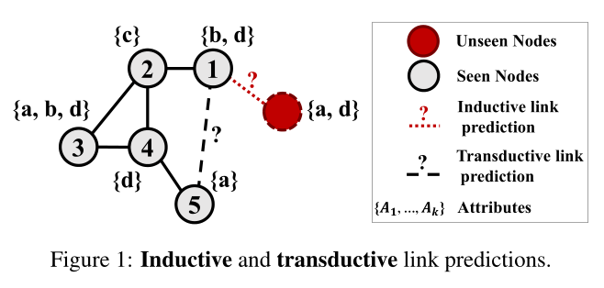
Introduction

Slide 4
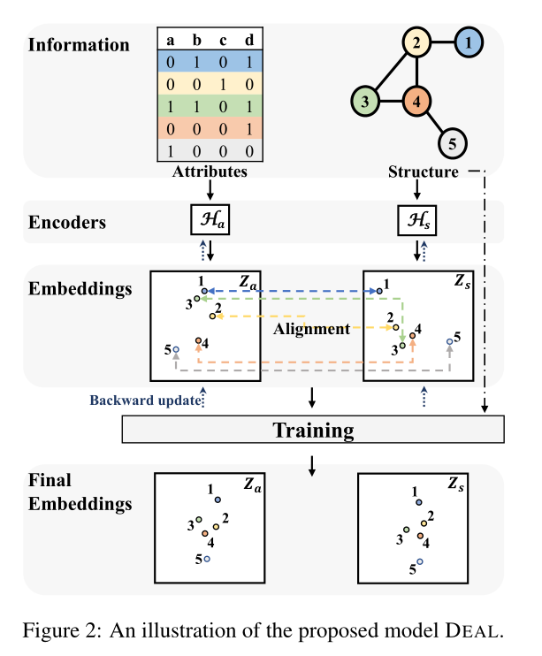
Method
Notes:
用MLP(多层感知器)来得到节点属性的embedding，其中激活函数是elu

Slide 5
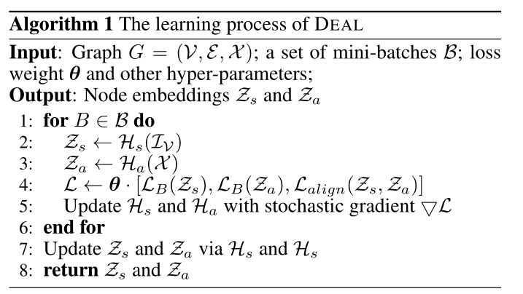
Method
Notes:
用MLP(多层感知器)来得到节点属性的embedding，其中激活函数是elu

Slide 6
Method
Notes:
分别计算attributies和structure的损失函数，其中对两个相连的节点做余弦相似度计算

Slide 7
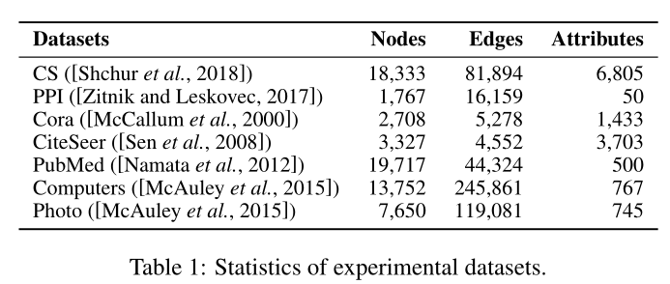
Experiments

Slide 8
Experiments

Slide 9
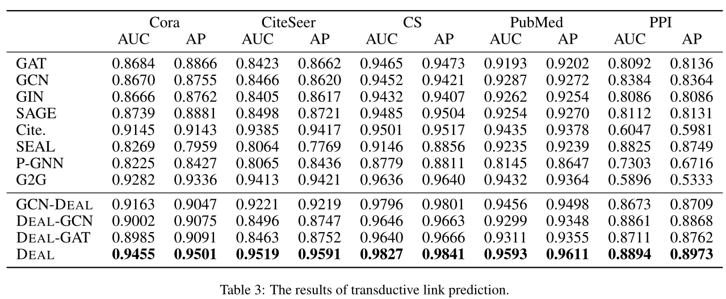
Experiments

Slide 10
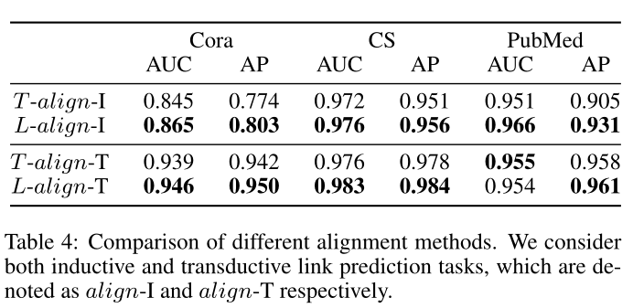
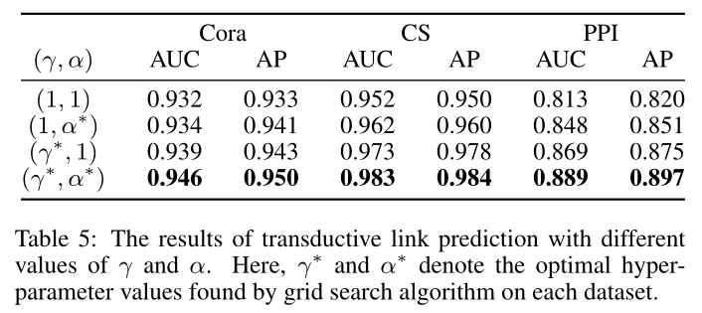
Experiments

Slide 11
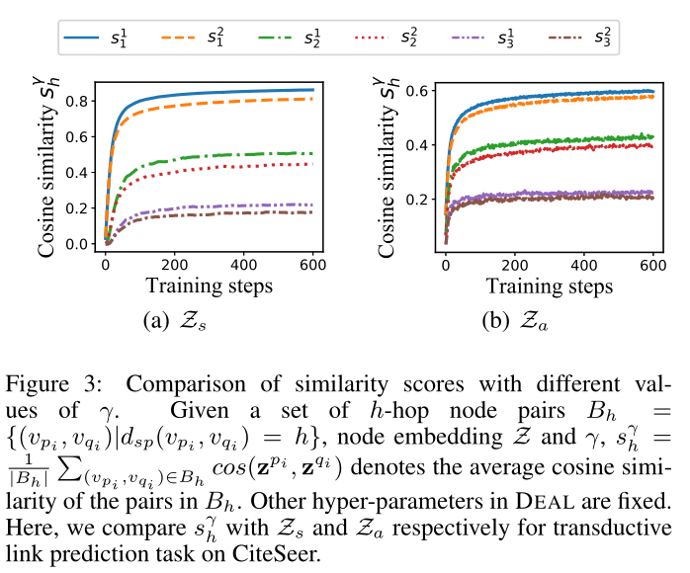
Experiments

Slide 12
Thank you!

